Slide 1

Operating systems
Lecture # 06

Slide 2
Lecture Overview
CPU Scheduling
Preemptive Vs Non-Preemptive
Process Scheduling Algorithms
Key Parameters in CPU Scheduling

Slide 3
CPU SCHEDULING
Scheduling of this kind is a fundamental operating-system function.
Almost all computer resources are scheduled before use.
Thus, its scheduling is central to operating-system design.
CPU Scheduling is the process of selecting which process from the ready queue should be executed next by the CPU. The main goal is to maximize CPU utilization and provide fairness among processes.

Slide 4
OBJECTIVES OF CPU SCHEDULING
🎯
Maximize CPU Utilization – keep the CPU as busy as possible
Maximize Throughput – increase the number of processes completed per time unit
Minimize Turnaround Time – reduce total time taken for a process to finish
Minimize Waiting Time – reduce time spent waiting in the ready queue
Minimize Response Time – improve interactive system performance
Ensure Fairness – give every process a fair chance to use CPU

Slide 5
Preemptive Vs non-preemptive
Non-Preemptive: Once the CPU is allocated, it runs until it finishes or moves to a waiting state.
The OS cannot forcibly take away the CPU.
Preemptive: The CPU can be taken away and given to another process (e.g., Higher Priority Process or Time Quantum).
A process may be moved from Running → Ready state before it finishes.

Slide 6
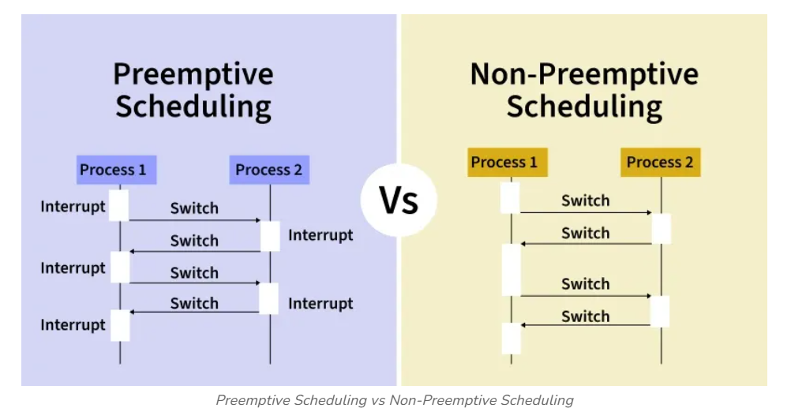
All modern operating systems including Windows, macOS, Linux, and UNIX use preemptive scheduling algorithms.

Slide 7
Preemptive and Non-preemptive Scheduling CPU-scheduling decisions may take place under the following four circumstances:
When a process switches from the running state to the waiting state (for example as the result of an I/O request or an invocation of wait() for the termination of a child process).
When a process switches from the running state to the ready state (for example, when an interrupt occurs).
When a process switches from the waiting state to the ready state (for example, at completion of I/O).
When a process terminates.

Slide 8
Scheduling Algorithms
🟢 Preemptive | Shortest Remaining Time First (SRTF)
 | Longest Remaining Time First (LRTF)
 | Round Robin (RR)
 | Priority Scheduling (Preemptive)
🔵 Non-Preemptive | First Come First Serve (FCFS)
 | Shortest Job First (SJF)
 | Longest Job First (LJF)
 | Highest Response Ratio Next (HRRN)
 | Multilevel Queue Scheduling
 | Priority Scheduling (Non-Preemptive)

Slide 9
Key Parameters in CPU scheduling
Arrival Time (AT) | The time when a process enters the ready state (i.e., when it arrives for execution).
Burst Time (BT) | Time required by a process to complete its execution on CPU. (Time Duration not point of time)
Completion Time (CT) | The time when a process finishes its execution completely.
Turnaround Time (TAT) | The total time taken by a process from arrival to completion. (Completion Time - Arrival time)
Waiting Time (WT) | The total time a process spends waiting in the ready state (not executing). (Turnaround Time - Burst time)
Response Time (RT) | The time from when a process arrives until it gets the CPU for the first time. (First Time – Arrival time)

Slide 10
Thank you!
“Stay curious, stay secure, and keep learning!”

